Slide 1
MEDICAL DEVICE FAILURE PREDICTION
REC – TEAM 11
‹#›

Slide 2
RAJALAKSHMI ENGINEERING COLLEGE
DEPARTMENT OF ARTIFICIAL INTELLIGENCE & MACHINE LEARNING
COGNIZANT- NURTURE PARTNER NETWORK PROGRAM -2025
Predicting Medical Device Failures Using Data Analytics and Random Forest
STUDENT MENTOR:
Mrs.Akshaya V
Assistant Professor (SG)
TEAM MEMBERS:
Sivadharishana TD (211501100)
Sri Balaji S (211501102)
Srinivas J (211501103)
Sriram Venkat P (211501105)
Srivarsan AR (211501106)
Srivatsan K (211501107)
CTS MENTOR:
Mr. Sivaramakrishnan
Ms. Krithika

Slide 3
PROBLEM STATEMENT
Medical devices play a crucial role in patient care. However, unexpected device failures can lead to serious consequences such as putting patients at risk, increasing operational expenses, and disrupting hospital workflows. Our challenge is to predict these failures before they happen, allowing us to take preventive action. Our goal is to create a robust system that combines historical data, relevant features, and real-time monitoring. By doing so,we aim to enhance patient safety, improve operational efficiency, and reduce maintenance costs associated with medical devices.

Slide 4
Idea formation
Step 1:Exploring Different Techniques for Device Failure Prediction:
Logistic regression struggles with non-linear relationships.
Decision trees can overfit easily.
Random Forest improves stability and accuracy by averaging predictions from multiple decision trees, making it ideal for this project.
Our requirement for Predicting medical device failure risk | WHY RANDOM FOREST?
Predict medical device failure risk to enhance patient safety. | Random Forest is robust for handling complex,
Early identification helps in preventing device failures. | non-linear relationships in large datasets.
Reduces healthcare costs by mitigating high-risk devices. | Handles missing data effectively and provides feature importance.
Proactive measures enable better decision-making for manufacturers and regulators. | Reduces overfitting by averaging multiple decision trees for more accurate predictions.

Slide 5
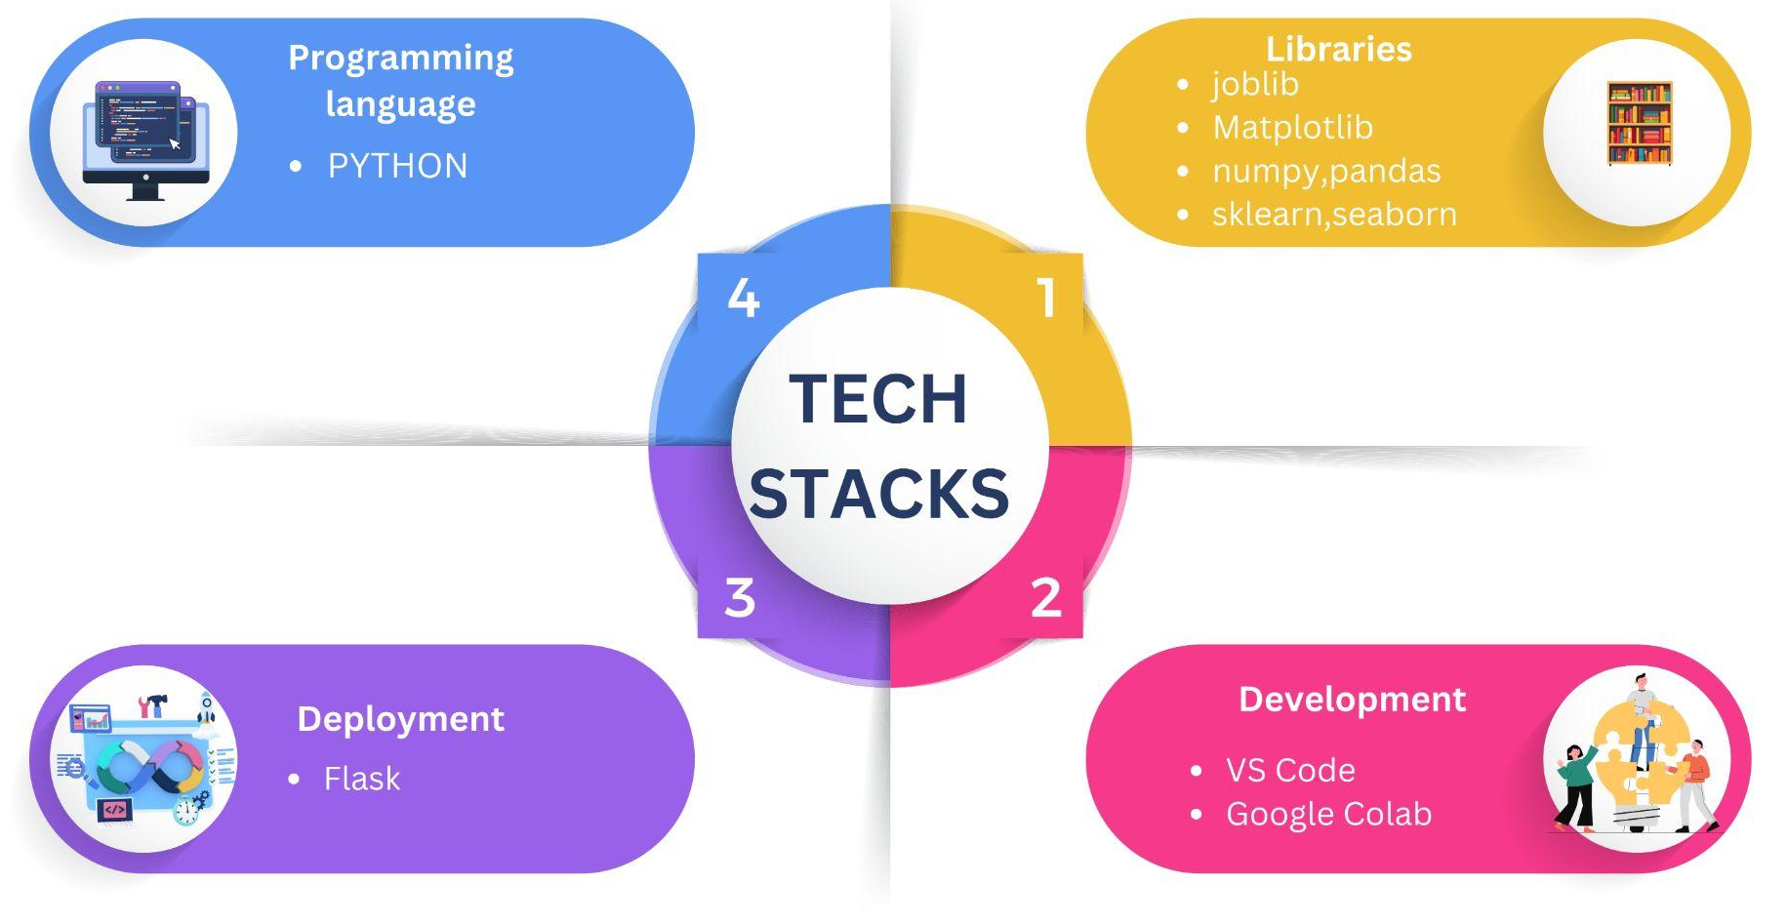
TECH STACKS

Slide 6
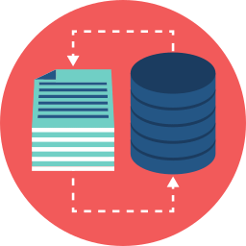
DATASET DESCRIPTION
Total Records : 72,604
Number of Features : 16
Input Variable : UID
Target Variable : risk_class
(Represents the failure risk level of the medical device : 1, 2, or 3)
Target Variable Distribution:
Risk Class 1: High risk
Risk Class 2: Moderate risk
Risk Class 3: Low risk
Other variables:
Device_id, classification, determined_cause, manufacturer_id, name_manufacture ,status ,implanted , name_device , action_classification

Slide 7
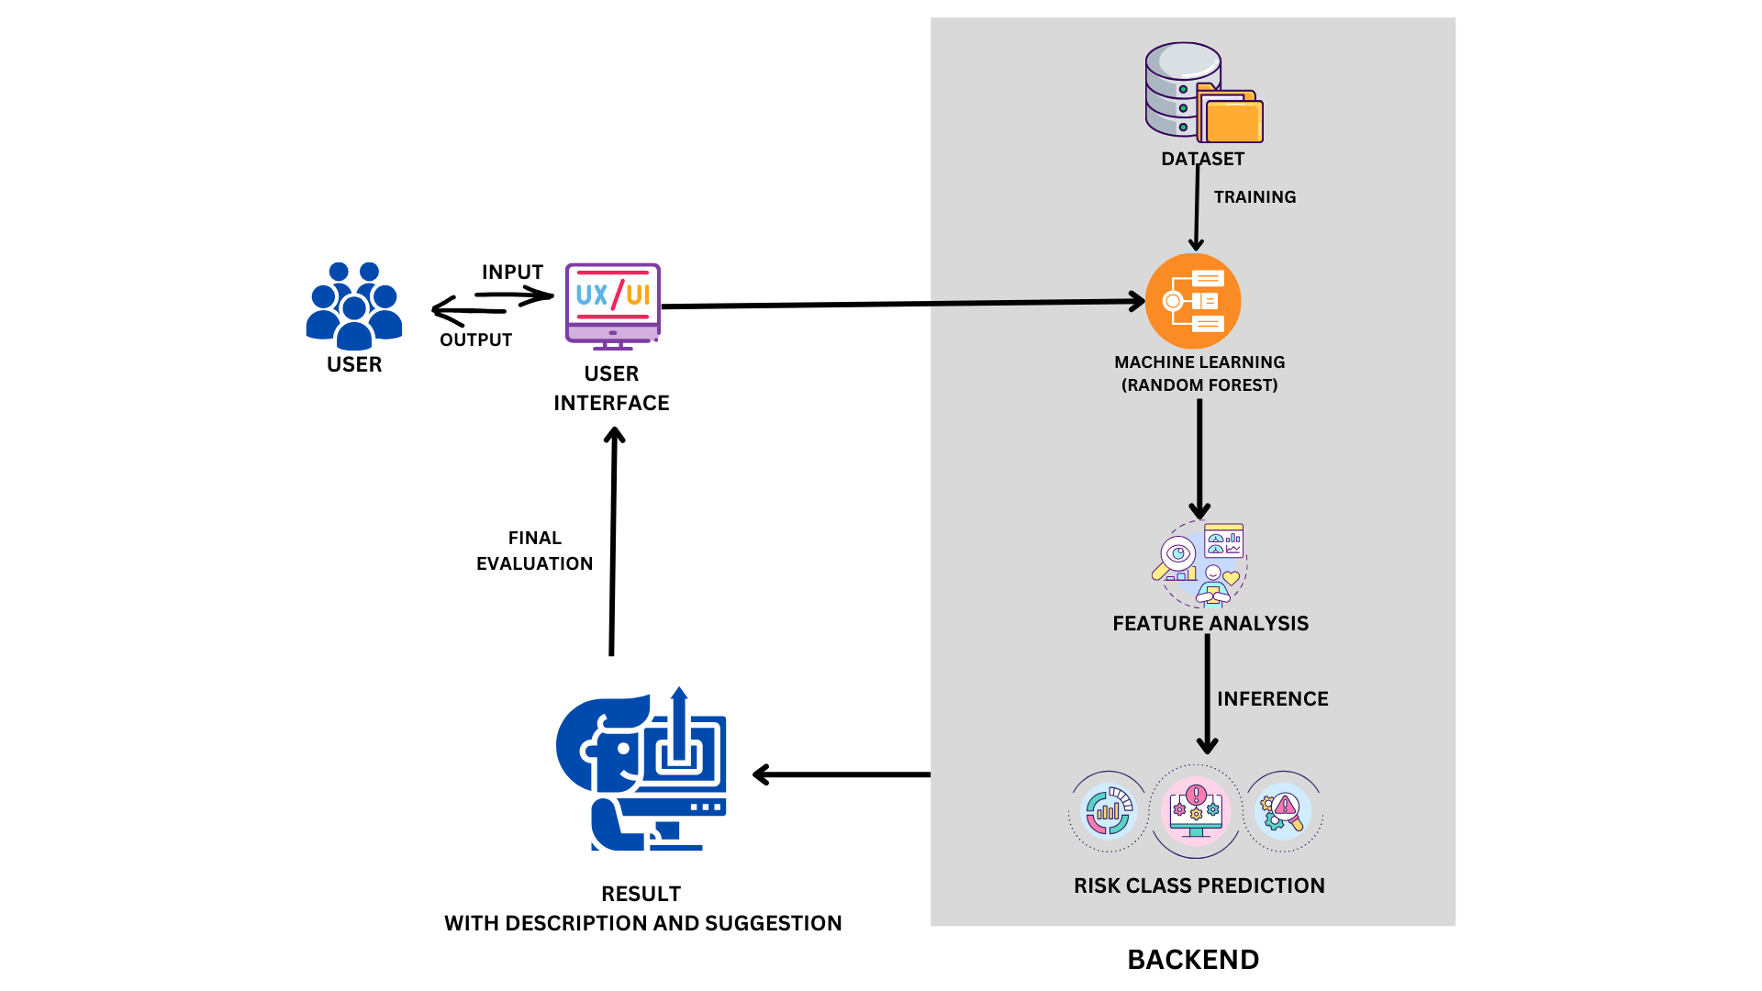
SYSTEM ARCHITECTURE

Slide 8
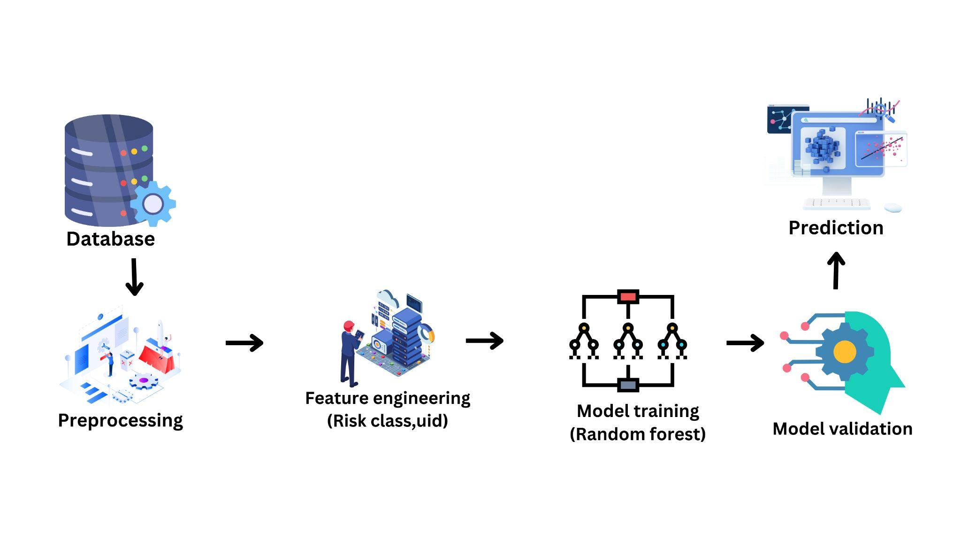
DATA WORKFLOW

Slide 9

DATA PREPROCESSING
Simple Imputation
Deduplication
Data Splitting
Data Integration
Data Visualization

Slide 10
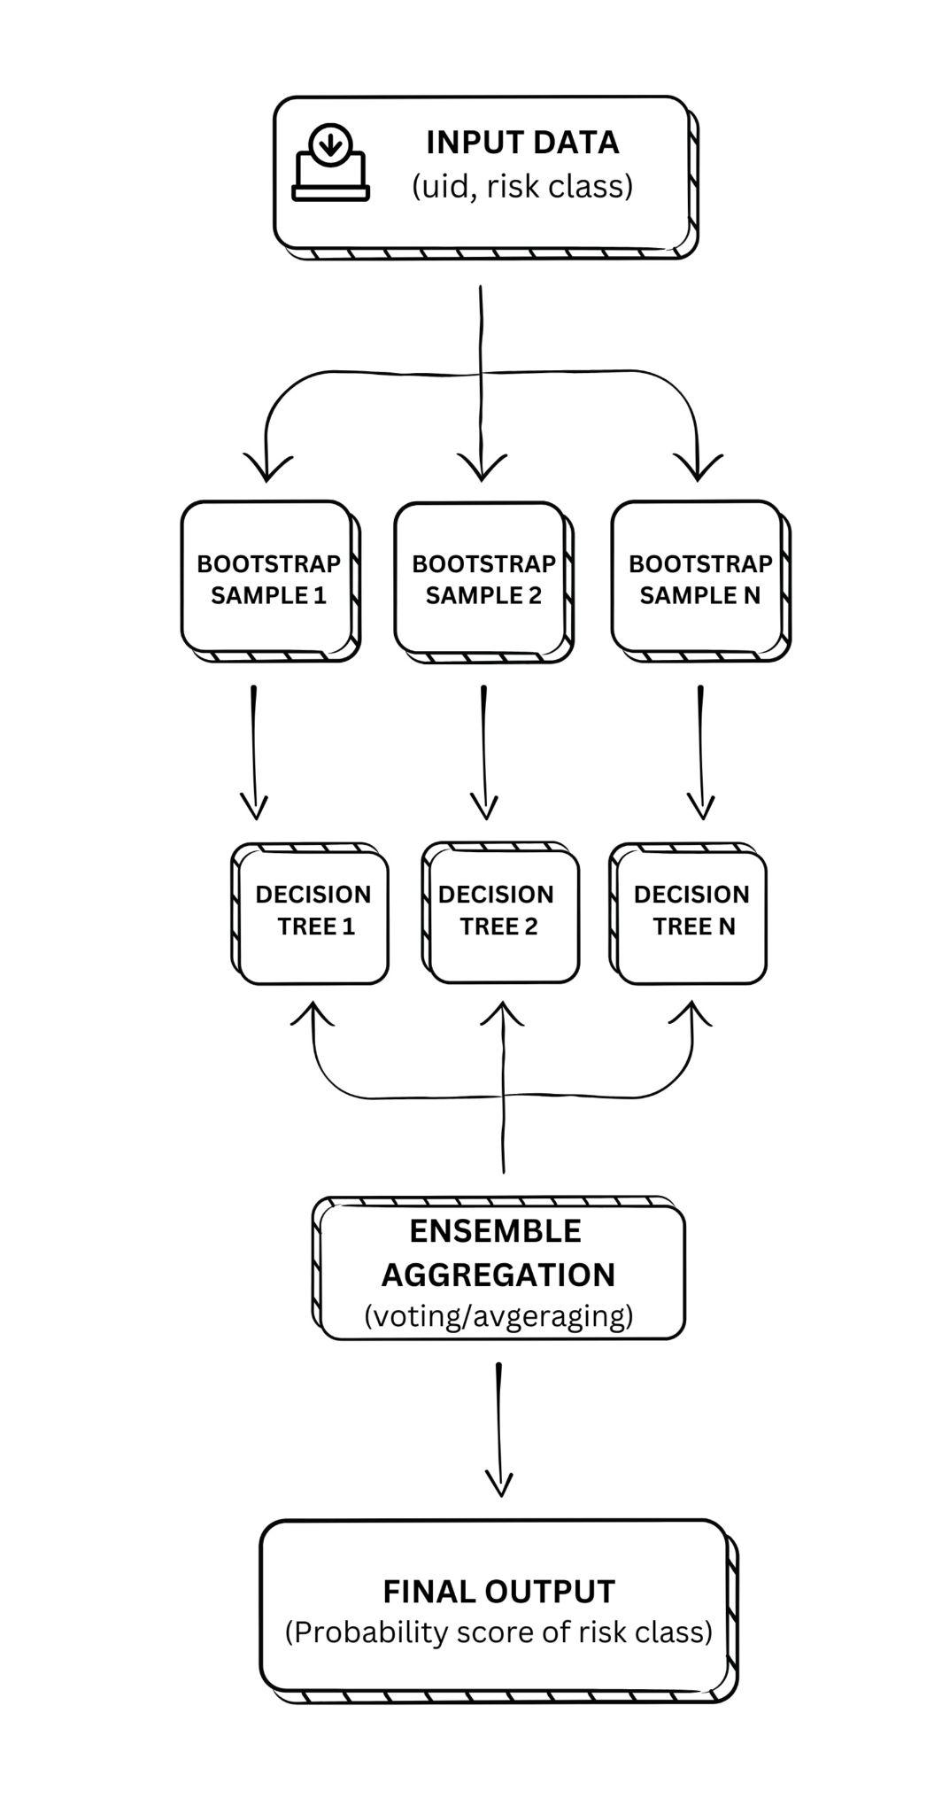
MODEL TRAINING
Random forest
Collection of the necessary details about the user’s medical device as input.
Predicts the failure : Risk class (1, 2, or 3) of medical devices based on historical recall data.
Uses multiple decision trees trained on features like device type, manufacturer, and cause of failure to improve the prediction.

Slide 11
MODEL TRAINING
Random forest
Benefits :
Accurate Risk Prediction
Handles Complex Data
Mitigates Overfitting
Feature Importance
Uniqueness :
Handles Missing Data
Non-linear Relationships
Scalability

Slide 12
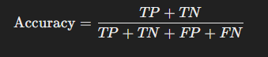

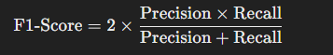
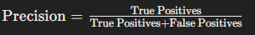
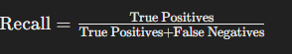
MODEL PERFORMANCE METRICS
Accuracy :
F1-Score :
Precision :
Recall :

Slide 13
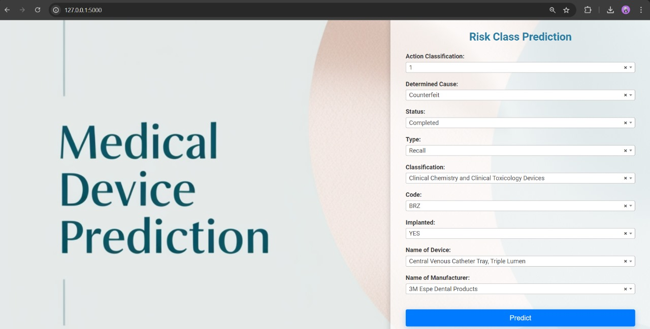
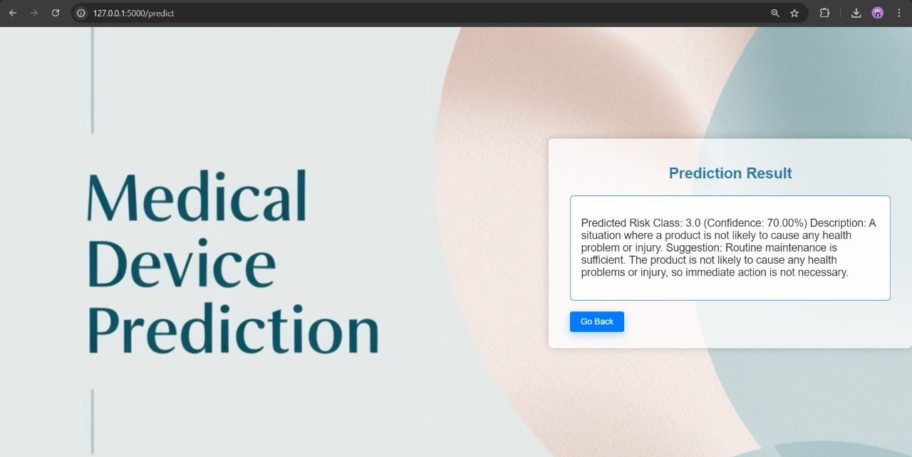
User Interface

Slide 14
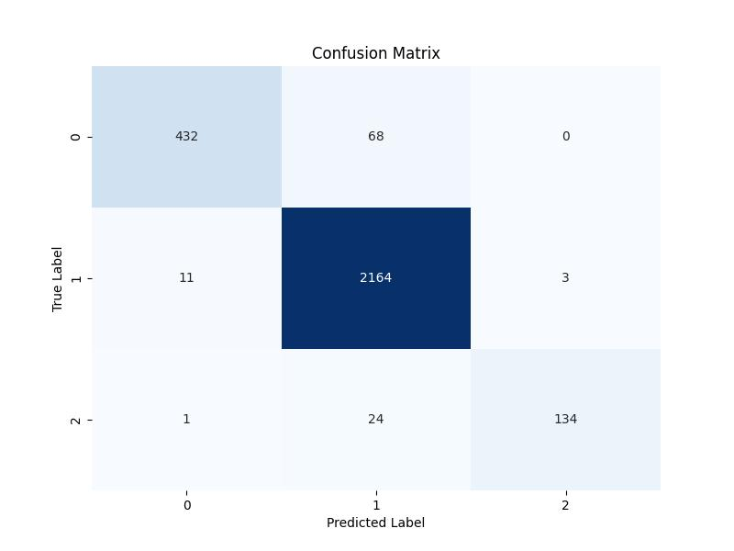
RESULT
Confusion matrix

Slide 15
Thank you!

